Slide 1
Video Game Sales

Slide 2
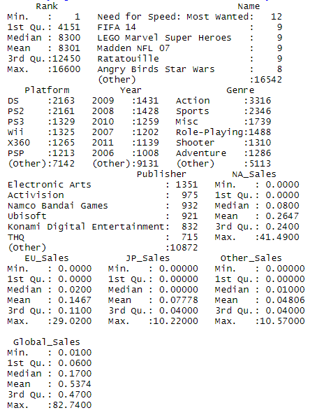
Summary Stats
The data set used was obtained from Kaggle and contains a list of video games with global sales of over 100,000 copies. Sales volumes are in millions. The dataset only contains games released between the years 1980 to 2016.
This research project is to observe trends in video games over the years through the number of games sold.

Slide 3
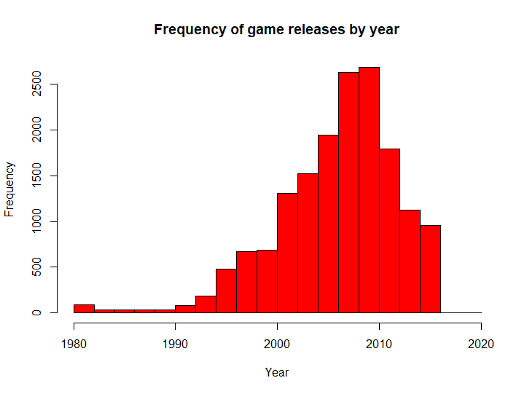
Frequency of game releases by year
We can see an increasing trend in the number of video games released over time. With the peak number of releases being in 2010. Although there seems to be a downward trend following that year. This is somewhat surprising as the with improvements in technology, one would expect number of games released to increase. However another way to look at this may be that with improvements in graphics, the quality of games released have been increasing in favor of quantity

Slide 4
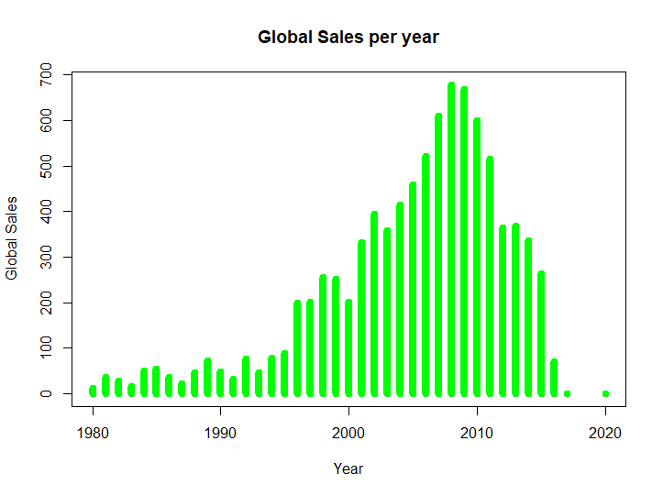
Global Sales per year
While there has been an overall increase in sales over time, following 2010 the sales volume can be seen to be decreasing, this is perhaps in direct relation to how fewer games have been released following 2010. While the dataset contains sales volumes of individual titles, it does not take into consideration the release of DLC(Downloadable content) which is often sold as an add-on to already released games. It also does not take into consideration additional costs such as online services and microtransactions which are what a lot of modern games tend to make money from

Slide 5
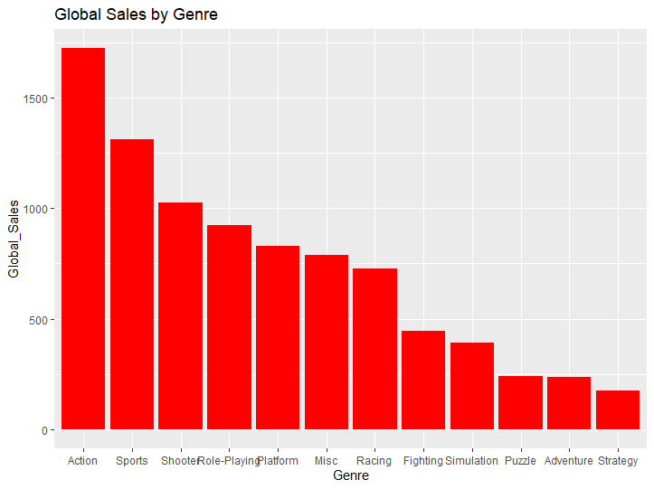
Global Sales by Genre
Action games seem to have the greatest number of sales globally whereas strategy has the least number of sales. Although Shooters, role-playing games and fighting games are ranked as separate genres despite the fact that these genres are often interchangeable with action. Hence the real question is perhaps where does the distinction lie between action games and other sub genres of games.

Slide 6
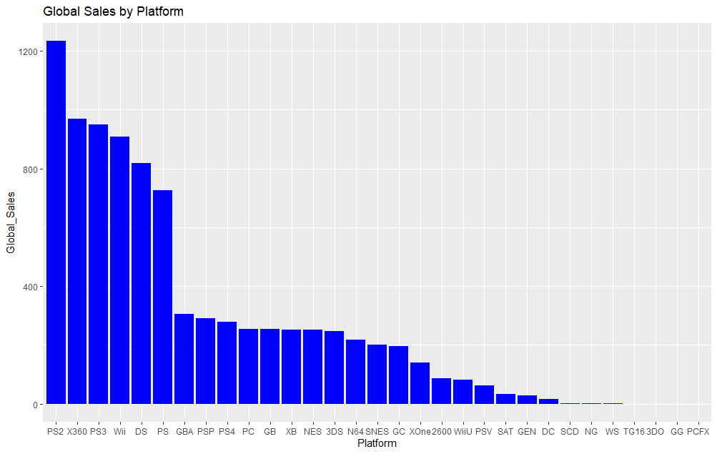
Global Sales by Platform
PS2 games by far have the greatest sales volumes compared to other platforms. Sony can be seen to be the leading competitor when it comes to games released for its systems with the PS, PS2, PS3 and the PS4 all having significant market share in sales volume. The PS was released in 2000 and the PS2 was released in 2006, which is when the largest increase in sales volumes can be seen in previous graphs. Newer generation consoles such as the PS4 and the XOne have fewer sales. This perhaps goes back into the idea of generating revenue through the sales of additional content and online services.

Slide 7
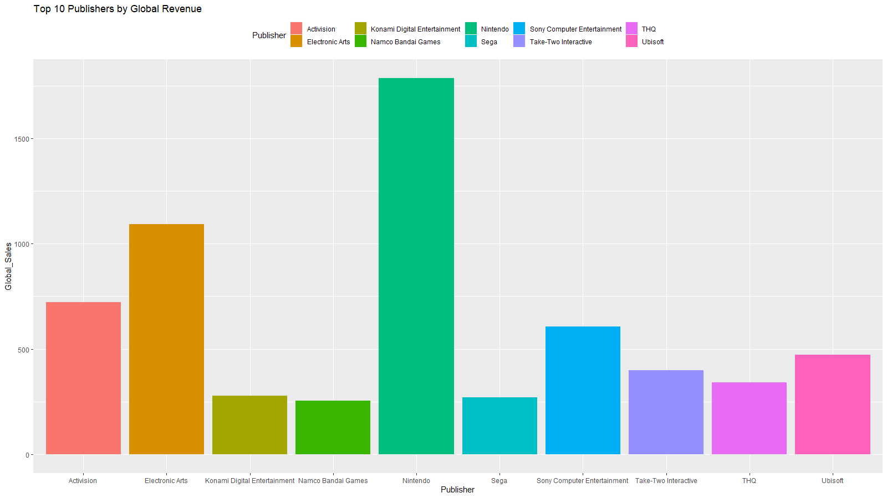
Top 10 Publishers by Global Sales
Nintendo appears to be the top publisher of video games. This is interesting as from previous graphs it can be seen that Sony’s PlayStation has greater the highest sales volumes and Nintendo games are never published for platforms other than its own. Perhaps this may be due the fact that other publishers release their games for Sony platforms thus if we were to combine sales from all other publishers and compare that to Nintendo, it would dwarf Nintendo’s sales volumes. Overall Nintendo has a pretty decent market share of platforms and it is the biggest publishers of games as well.

Slide 8
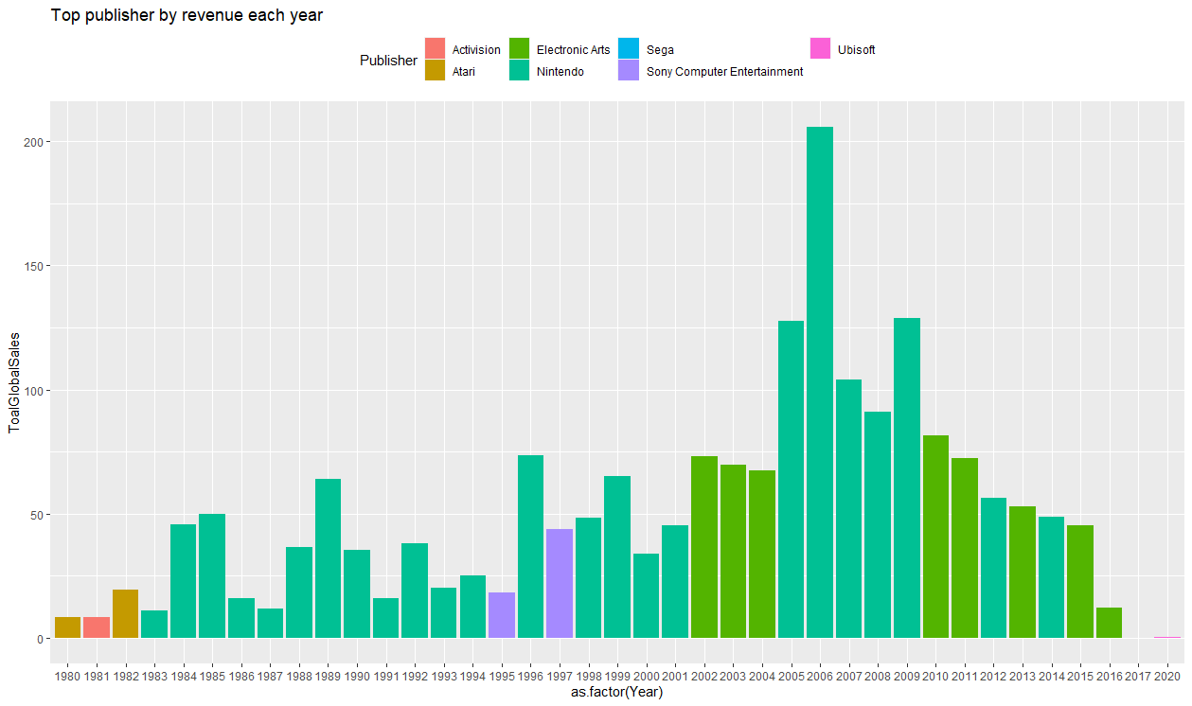
Top publisher by revenue each year
Nintendo as a publisher for games clearly owns the greatest market share in terms of overall sales volumes throughout, which is in line with the previous graph. It has also been the top publisher for games in multiple years. It would be interesting to see how other publishers fared in those same years as Nintendo

Slide 9
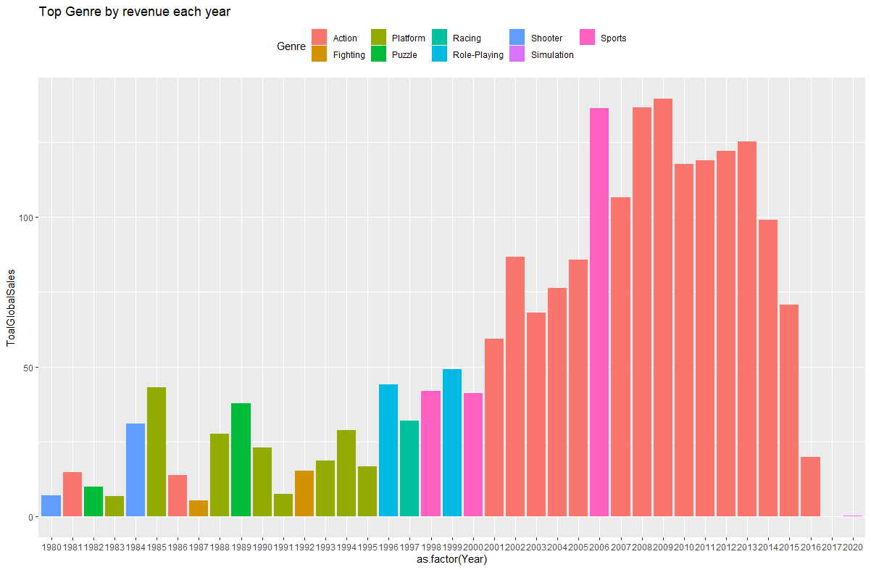
Top Genre by Global sales each year
Action games hold the greatest sales volumes through out multiple years. More action games have been sold since 2001 only being disrupted by sports games in 2006. It would be interesting to look into what the top sports game that was released in that year. More games were sold in other genres prior to 2001. Perhaps with advancements in graphics and processing, action games became easier to make in following years

Slide 10
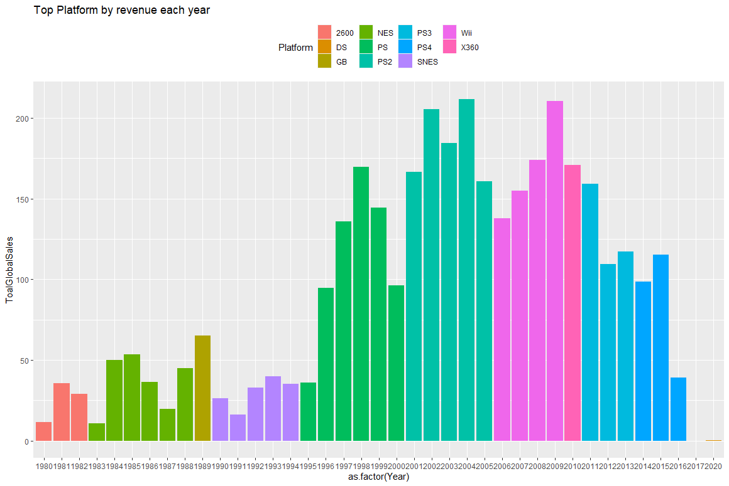
Top Platform by Revenue each year
The Wii was the most popular platform between 2006 to 2009 which would perhaps explain Nintendo’s hold as the top publisher of games. The PS2 was the most popular platform between 2001 and 2005, the PS being the most popular between 1995 and 2000, the PS3 between 2011 and 2013 and the PS4 from 2014 onwards. With Sony being the top platform in multiple years, particularly during the peak years of game release, it makes sense it dominated as the platform of choice.

Slide 11
Issues with the dataset
The dataset itself only contains game releases up to the year 2016 and hence might contain incomplete data for that year. The games listed and their sales amounts are only based on its year of release and its sales during release. Some games may have sold more in the following years and the data does not take that into account. Some games, particularly those released in the late 2010s are also released such that more copies are sold in following years as the games are constantly updated and more players buy those games. Many games also have DLC released for its which players must purchase separately, accounting for a greater portion of the revenue that is earned by publishers. With improvements in broadband connection, publishers are earning more revenue through online services and subscription models. Hence a game might be released for long term playability through in-game purchases and subscription models. The dataset also does not account for mobile games which has seen more growth in recent years. One thing to note about

Slide 12
Sales by Region
In progress. This compares sales volumes in different regions as a factor of the global sales.

Slide 13

Correlation of sales among regions
While there is mostly positive correlation between sales in different regions, only the correlation with global sales can be considered of note. Higher sales in certain regions would affect global sales as opposed to between certain regions. Correlation between other factors with global sales such as platform, genre and publisher might give more insight into sales trends however.

Slide 14
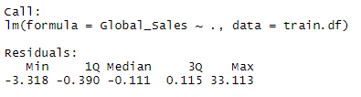

Linear Regression model of Global sales against Genre, Platform and Publisher

Slide 15
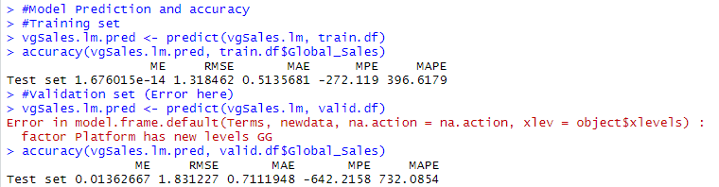
Model prediction and accuracy

